Slide 1
US Car accident analysis
Data Science Bootcamp 2023

Slide 2
AGENDA
Introduction
Location Analysis
Time Analysis
Weather Analysis
Summary

Slide 3
Introduction

Slide 4
INTRODUCTION
This is a countrywide car accident dataset that covers 49 states of the USA. The accident data were collected from February 2016 to March 2023, using multiple APIs that provide streaming traffic incident (or event) data. These APIs broadcast traffic data captured by various entities, including the US and state departments of transportation, law enforcement agencies, traffic cameras, and traffic sensors within the road networks. The dataset currently contains approximately 7.7 million accident records. For more information about this dataset, please visit here.

Slide 5
SCOPE OF ANALYSIS
Location Analysis
Time Zone
State
City
Street
Time Analysis
Year
Month
Day
Hour
Weather Analysis
Temperature
Humidity
Precipitation
Wind Speed
Wind Chill
Weather Conditions
1
2
3

Slide 6
Questions
How are the basic weather conditions in most of the accident cases in US ?
How wind, temperature, humidity, visibility, precipitation affect driving?
Which states, cities had the most car accidents?
In which month, day, hour do most car accident happen?

Slide 7
Location Analysis

Slide 8
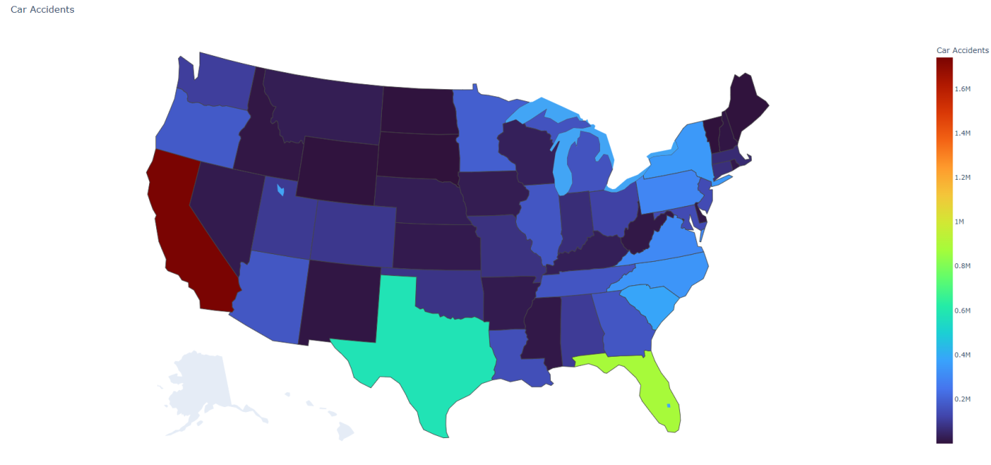
Heatmap of accidents per state

Slide 9
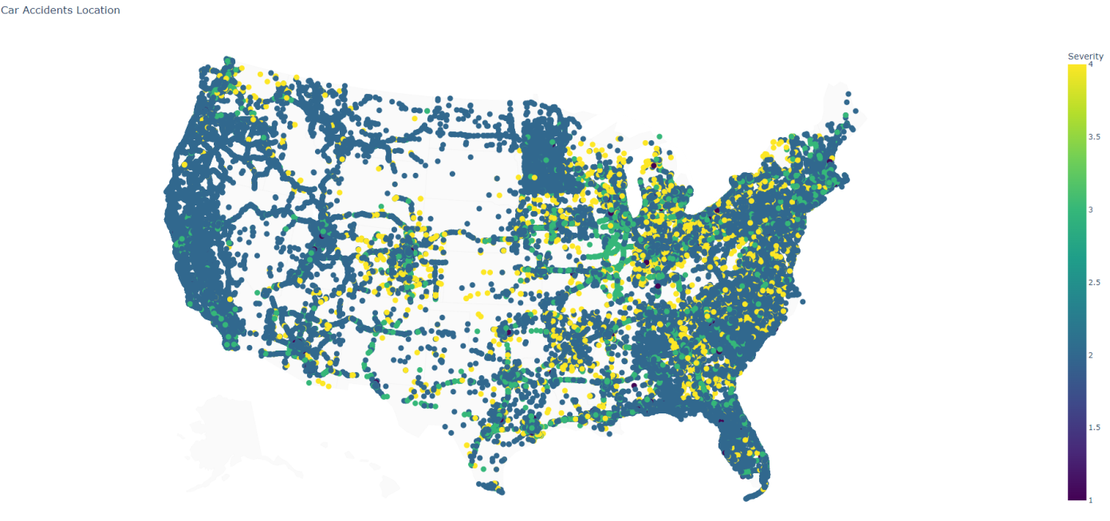
Heatmap of accidents’ severity

Slide 10
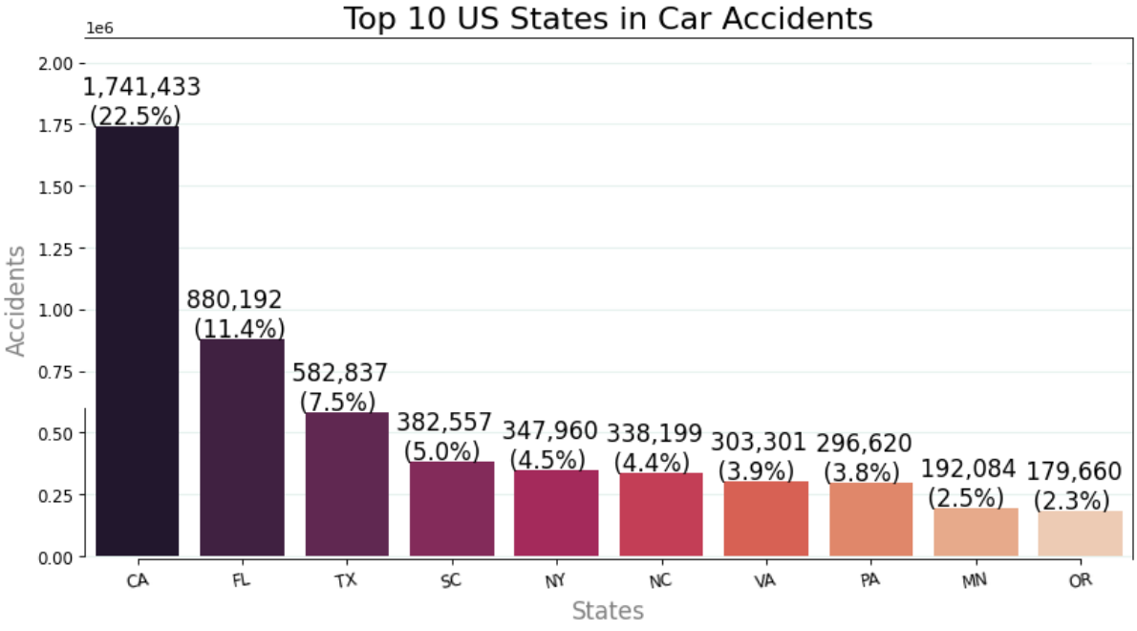
Most accidents occurred in California, Florida & Texas*
*We must notice that these states have the biggest population.

Slide 11
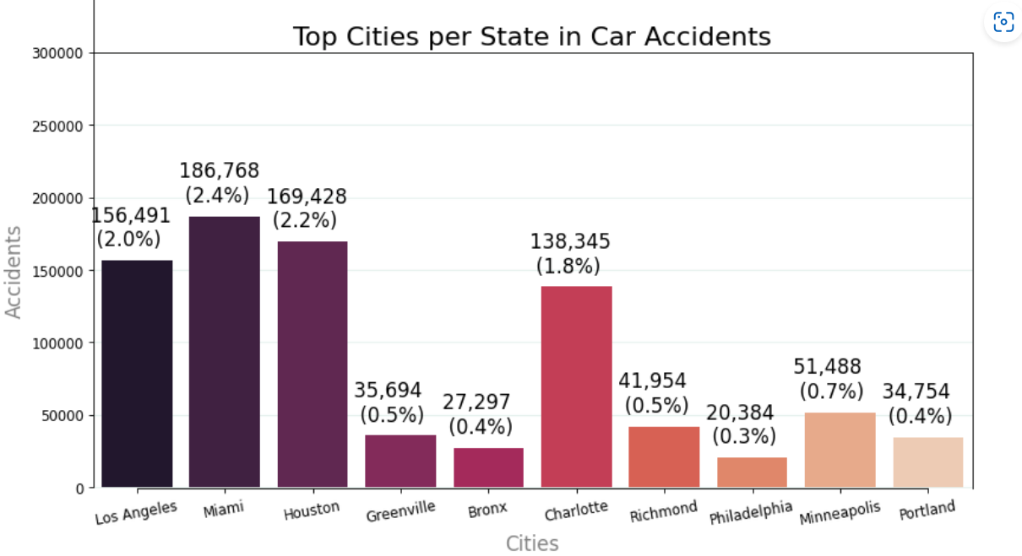
Most accidents occurred in los angeles, Miami & houston

Slide 12
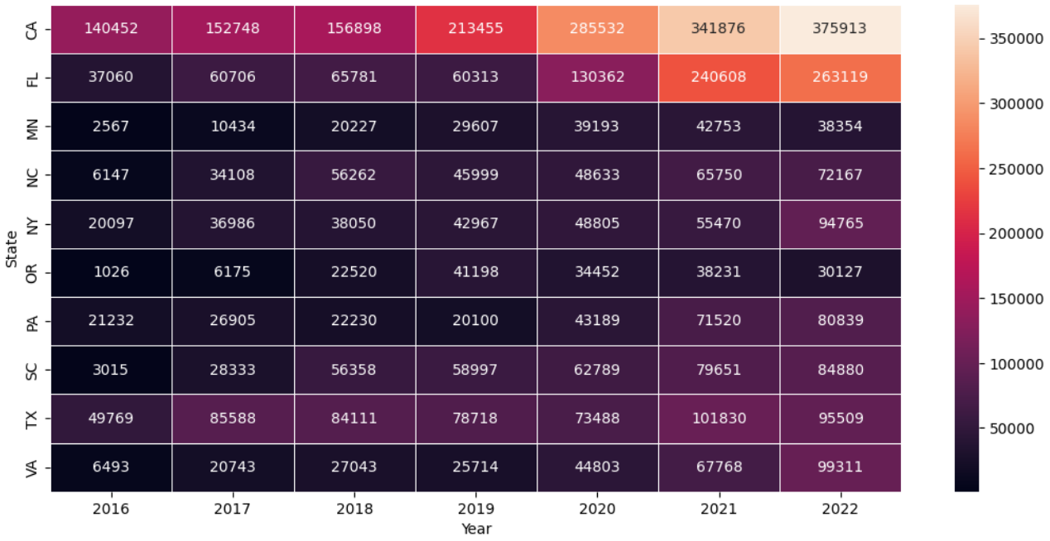
increase in accidents in top ten states per year

Slide 13
Time Analysis

Slide 14
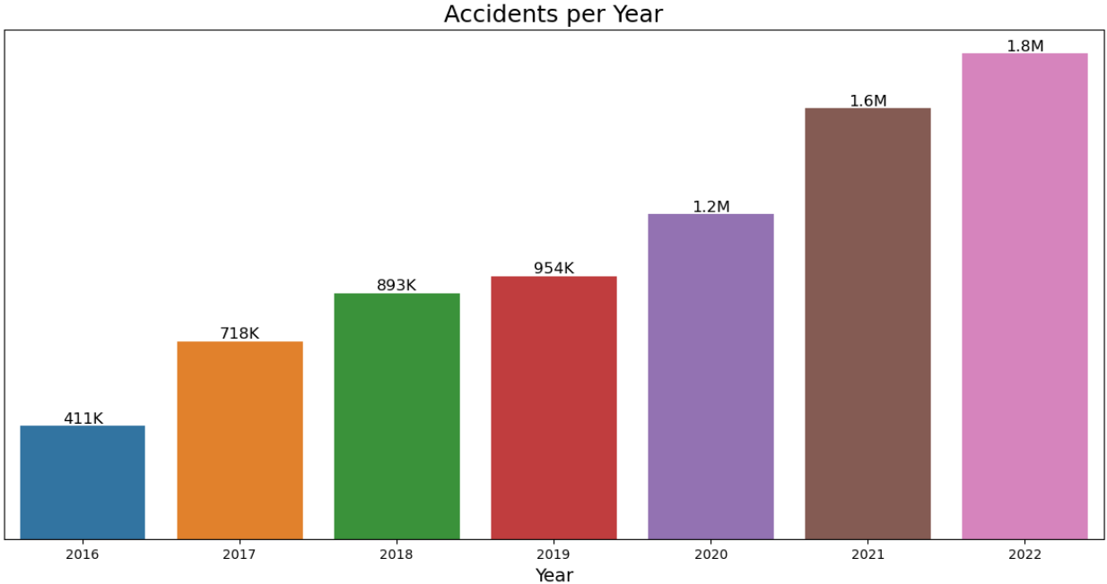
there is an increase in accidents per year which can be attributed to the ever-increasing number of cars

Slide 15
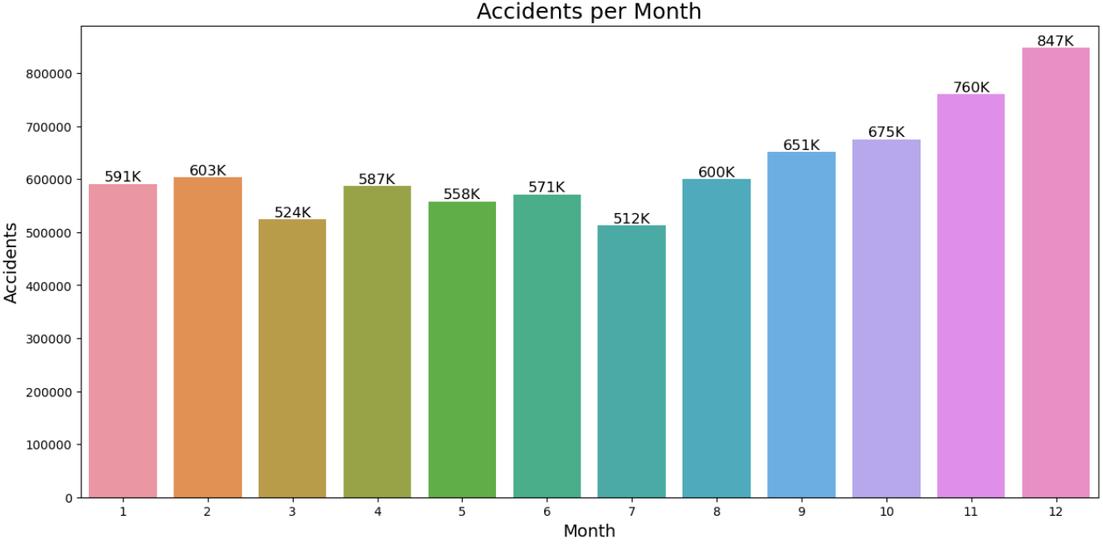
Overall, December seems to be the month with the most car accidents possibly due to the increased traffic from the Christmas Holidays

Slide 16
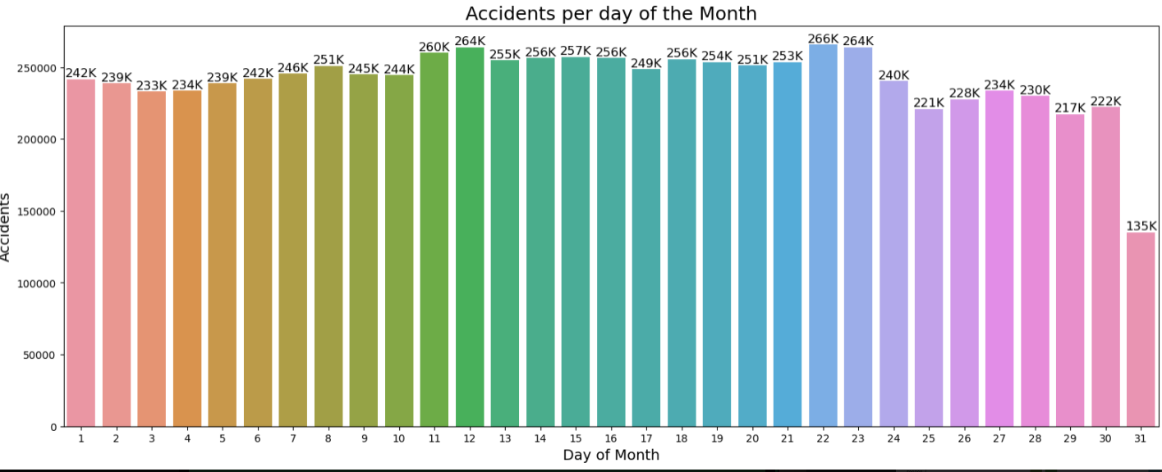
Accidents per day of month

Slide 17
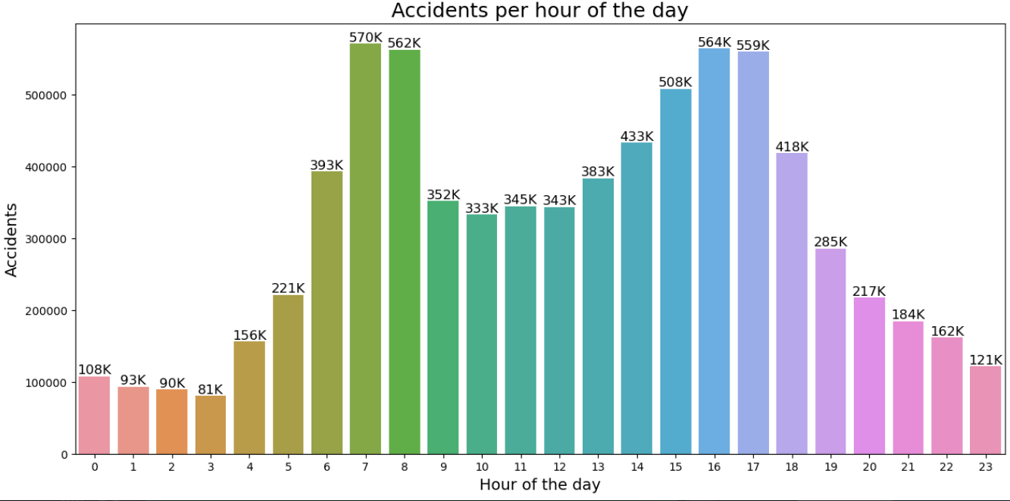
Most accidents occur during morning and evening hours, due to traffic of employees

Slide 18
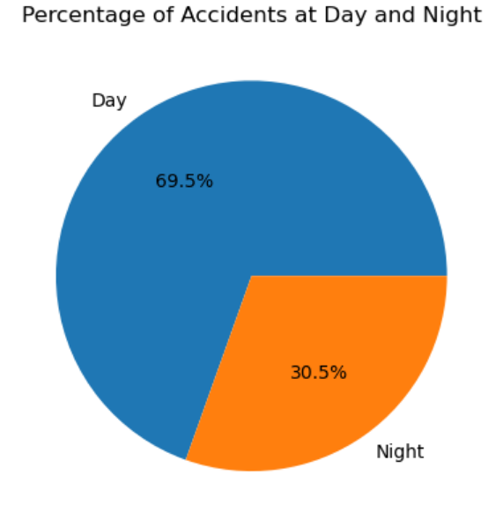
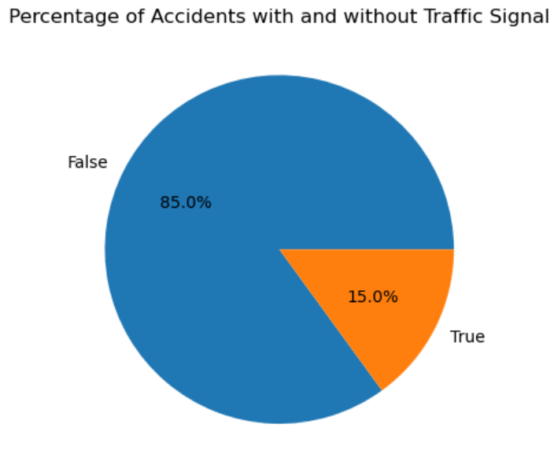
Most accidents occur at day
15% of total accidents occurred due to signal VIolation

Slide 19
Weather Analysis

Slide 20
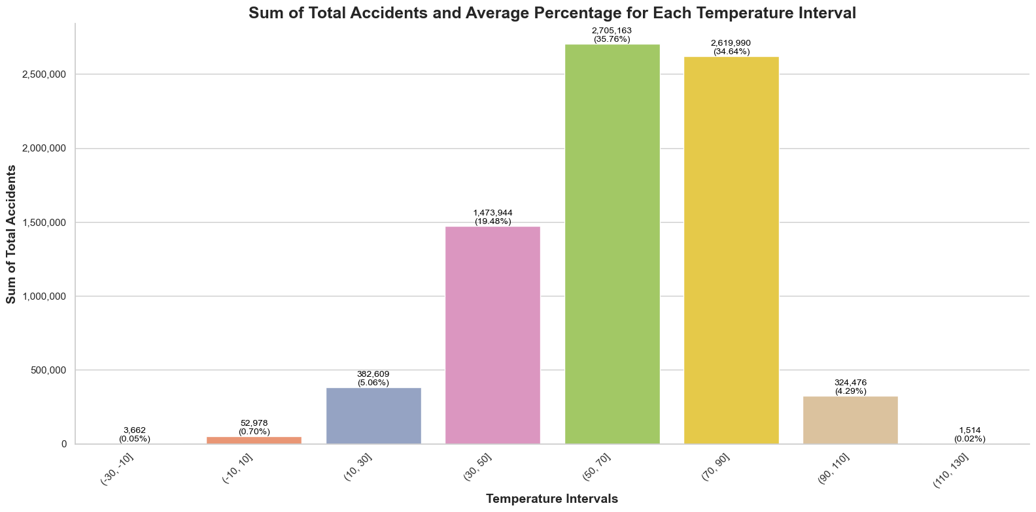
In the temperature range of 50(F) - 70(F), 35,76% of the road accidents occurred

Slide 21
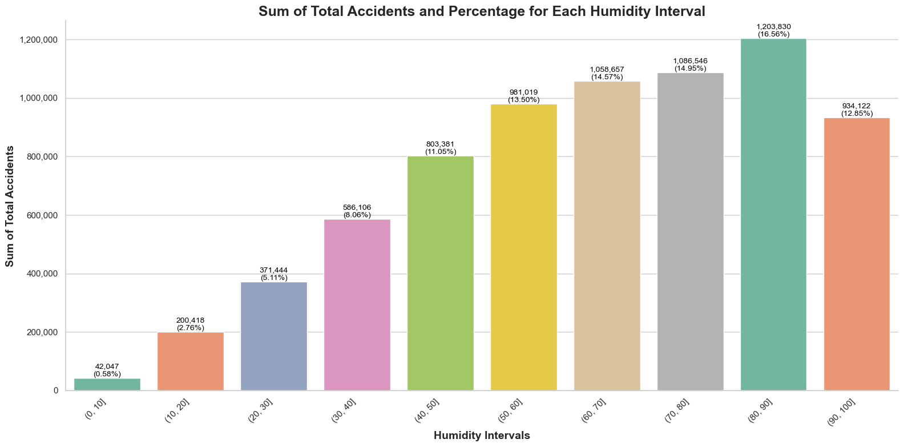
In the humidity range of 80(%) - 90(%), 16,56% of the road accidents occurred

Slide 22
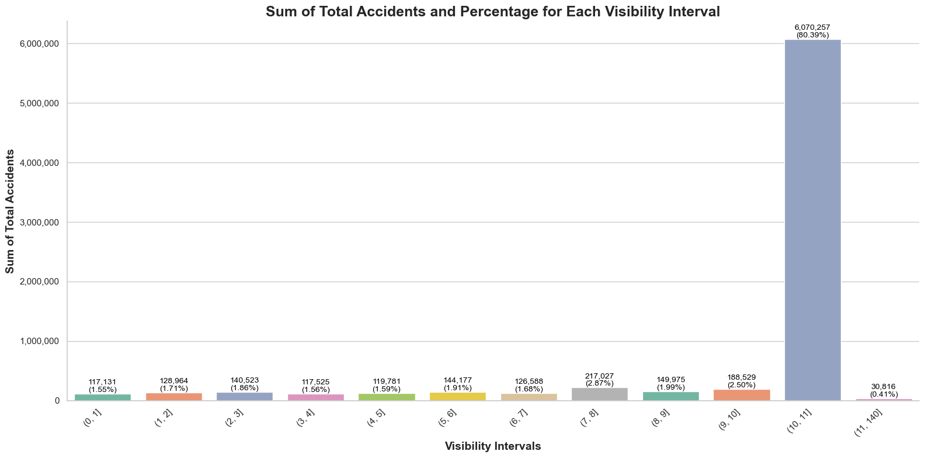
In the visibility range of 10(mi) - 11(mi), 80,39% of the road accidents occurred

Slide 23
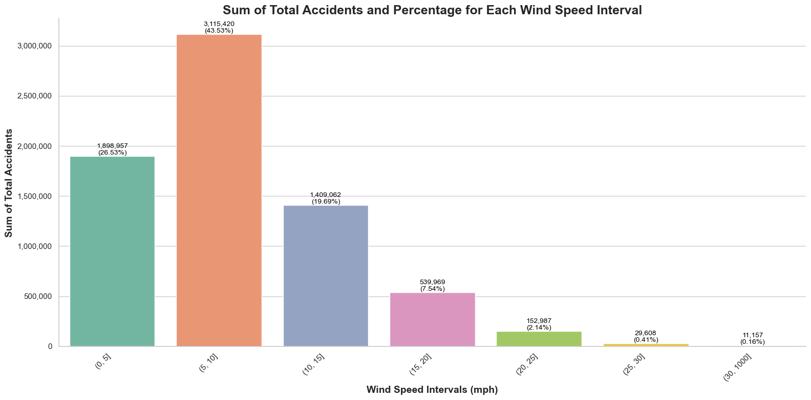
In the wind speed range of 5(mph) - 10(mph), 43,53% of the road accidents occurred

Slide 24
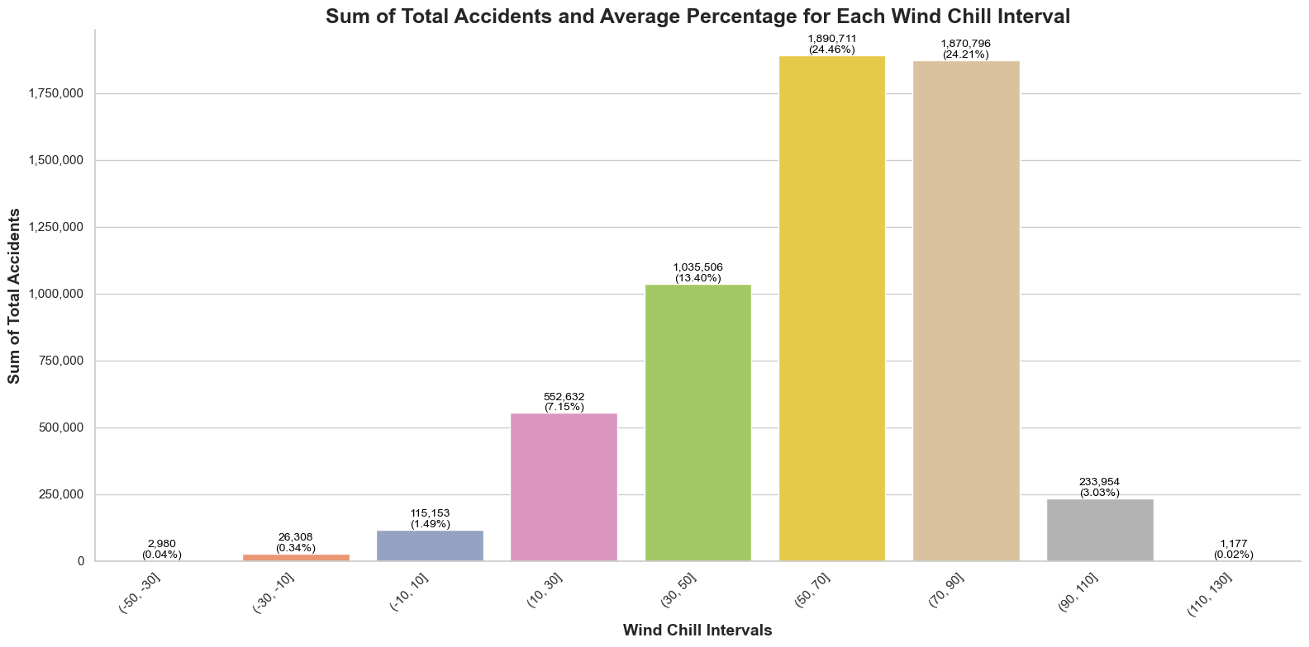
In the wind chill range of 50(F) - 70(F), 24,46% of the road accidents occurred

Slide 25
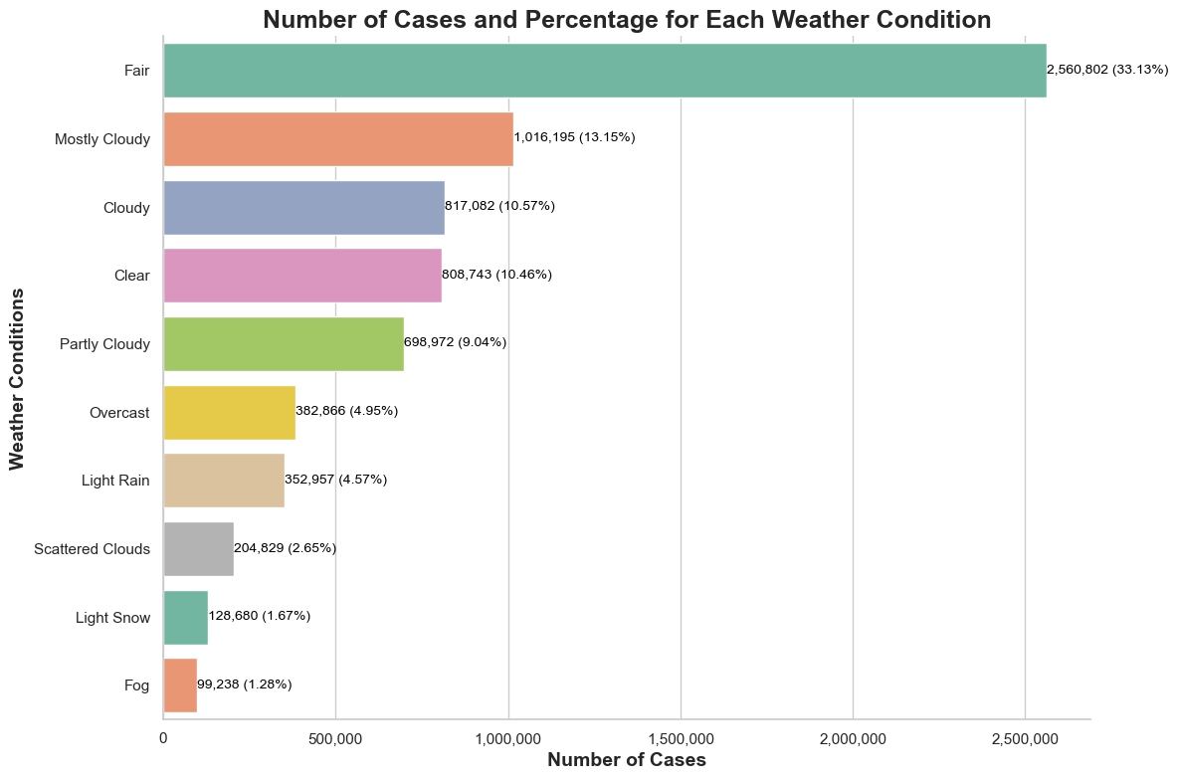
In fair conditions, 33,13% of the road accidents occurred

Slide 26
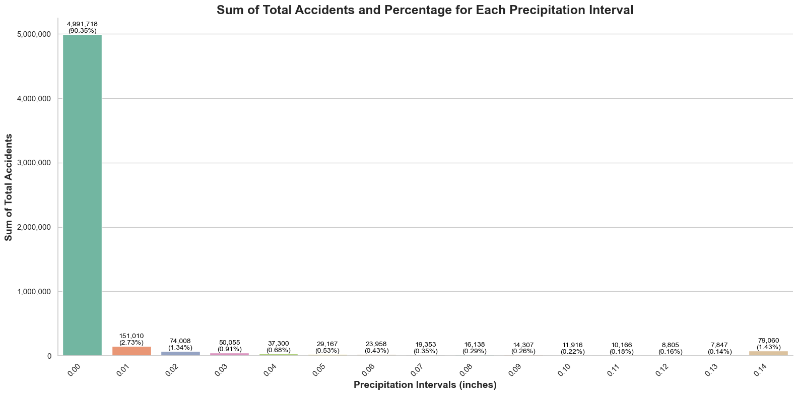
it has been observed that approximately 90% of the accidents occurred under dry conditions with a precipitation value of 0.00*
*For 70% of the recorded accidents where precipitation information is available,

Slide 27
Summary

Slide 28
Highlights
Most Accidents Occur in California
2. Most Accidents Occur in December and
during Morning and Evening Hours
3. Most Accidents Occur with High Humidity
and Fair or Cloudy Weather Conditions

Slide 29
THANK YOU
Giannis Panagiotopoulos
Stavros Xakis
Fotis Karamplias

